Slide 1
Week 7, Day 2: Introduction to Data Visualization
Python Programming Bootcamp - 3-Hour Session

Slide 2
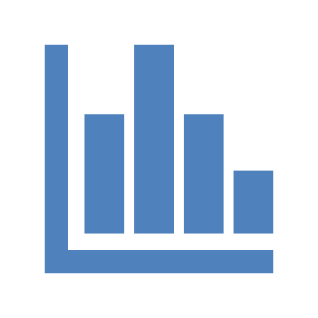
Learning Objectives
• Understand the importance of data visualization
• Learn to use popular libraries like Matplotlib and Seaborn
• Create basic visualizations: bar plots, line charts, histograms, etc.
• Customize visualizations for readability and aesthetics

Slide 3
What is Data Visualization?
Data Visualization is the representation of data through visual elements like charts, graphs, and maps.
Enhances understanding of data
Reveals trends, patterns, and insights
Helps in data-driven decision making

Slide 4
Importance of Data Visualization
Why visualize data?
• Simplifies complex data
• Improves comprehension
• Identifies trends and outliers
• Enables effective communication of insights

Slide 5
Popular Python Libraries for Visualization
• Matplotlib: Basic plotting library in Python
• Seaborn: Built on Matplotlib, provides statistical visualizations
• Plotly: Interactive, web-based visualizations

Slide 6
Bar Plots
Ideal for comparing categories. Examples: Sales by region, Exam scores per subject.
Task: Use Matplotlib to create a bar plots using provided data.

Slide 7
Line Charts
Used to show trends over time. Examples: Monthly revenue, Daily temperatures.
Task: Use Matplotlib to create a line charts using provided data.

Slide 8
Histograms
Displays data distribution. Useful for: Age distribution, Income levels.
Task: Use Matplotlib to create a histograms using provided data.

Slide 9
Scatter Plots
Shows relationships between two variables. Examples: Weight vs. Height, Marketing spend vs. Sales.
Task: Use Matplotlib to create a scatter plots using provided data.

Slide 10
Pie Charts
Represents parts of a whole. Examples: Market share, Budget allocation.
Task: Use Matplotlib to create a pie charts using provided data.

Slide 11
Customizing Visualizations
Enhance readability by customizing:
• Titles and labels
• Color schemes
• Legends
• Annotations
Task: Customize a bar plot with title, axis labels, and different colors.

Slide 12
Assignment
1. Create a dashboard visualizing sales, expenses, and profit trends.
2. Use at least three types of visualizations.
3. Integrate visualizations into a single dashboard layout.

